Slide 1
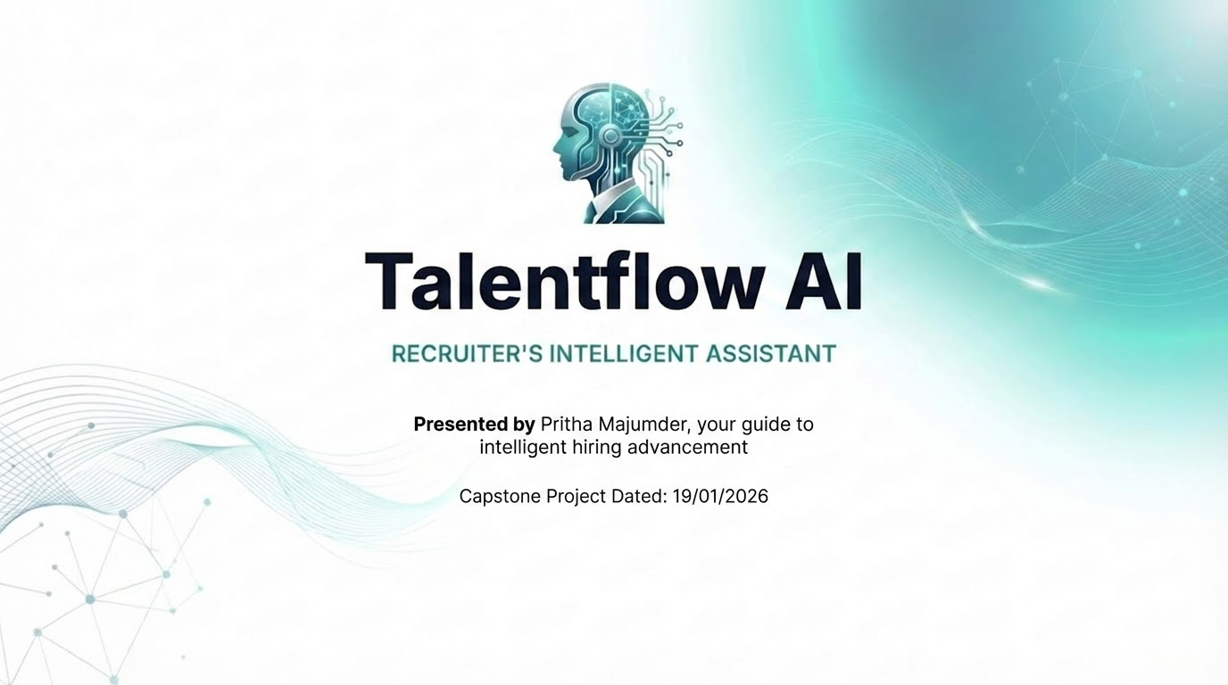

Slide 2


The Recruitment Bottleneck: 250+ Resumes
The "Manual" Reality
Corporate hiring managers are overwhelmed. The average job opening receives 250+ resumes.
Time Consuming: 23 hours spent screening per hire.
Biased: Unconscious bias affects candidate selection.
Inconsistent: JDs vary wildly in quality across teams.
Talentflow AI automates the repetitive "grunt work," allowing recruiters to focus on people, not paper.

Slide 3

Tool Limitations Today
Traditional tools lack contextual understanding for effective hiring.
Outdated methods often result in missing top talent.
Relying on keyword matching overlooks nuanced candidate fit.
Limitations lead to missed opportunities in talent identification.

Slide 4
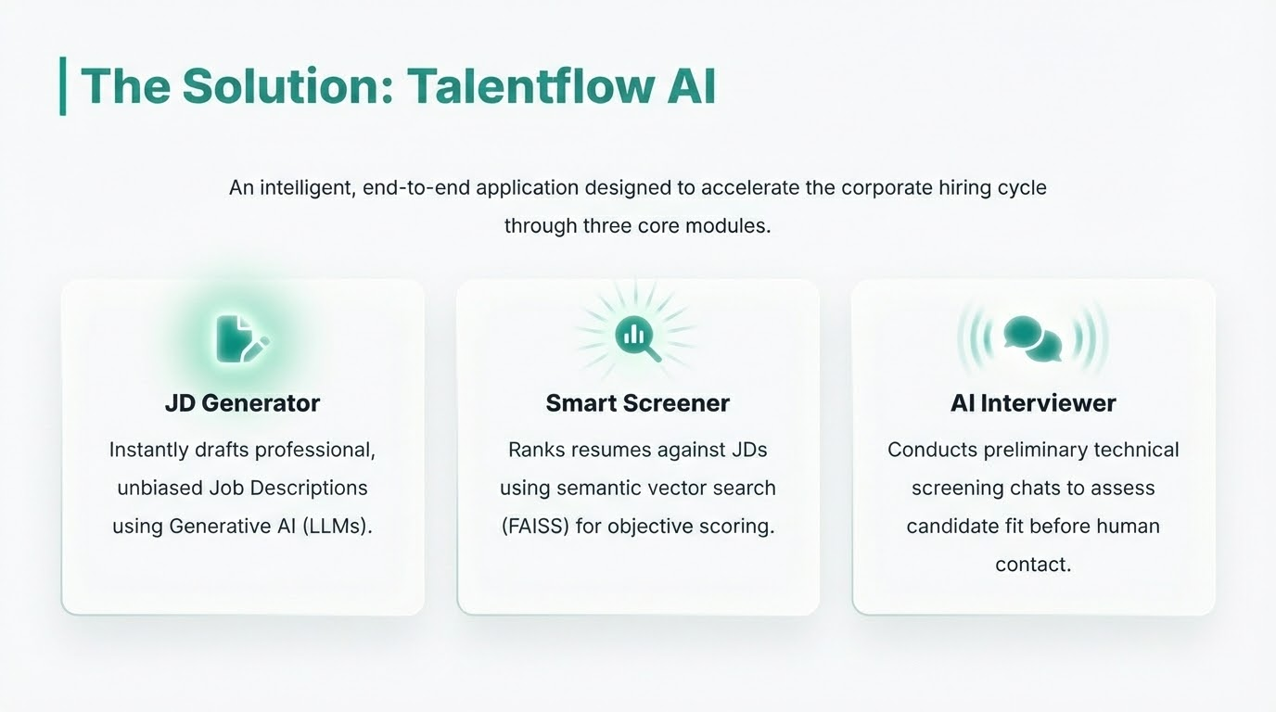

Slide 5
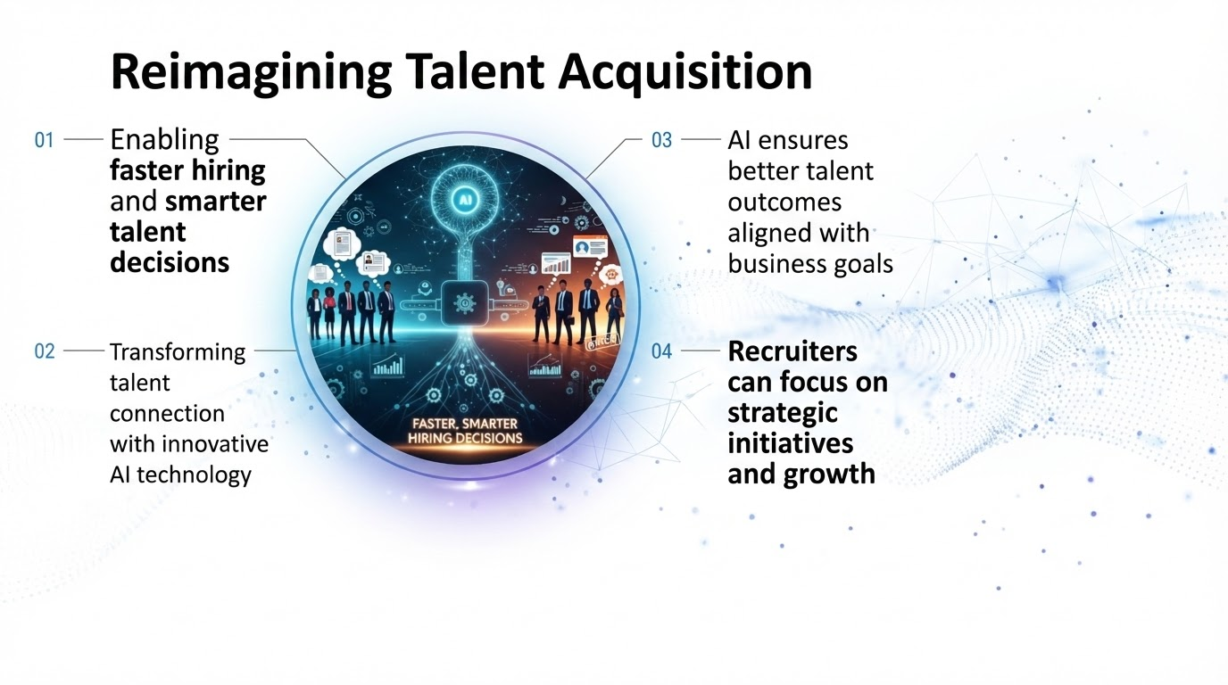

Slide 6
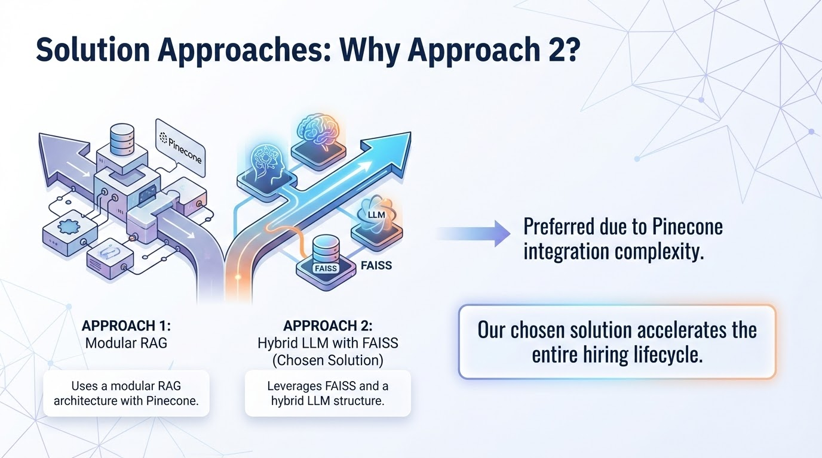

Slide 7
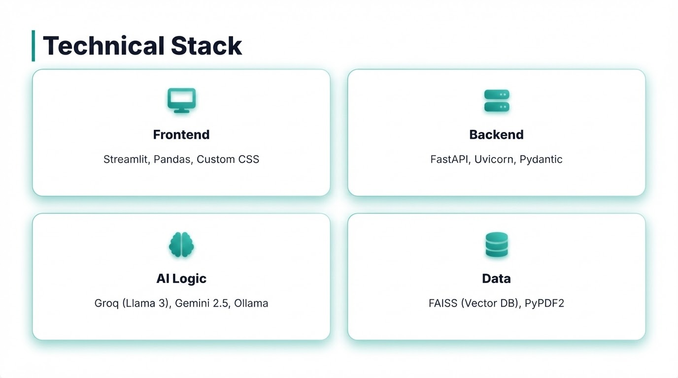








Technical Stack
Frontend
Backend
Streamlit, Pandas, Custom CSS
FastAPI, Uvicorn, Pydantic
AI Logic
Data
Groq (Llama 3), Gemini 2.5, Ollama
FAISS (Vector DB), PyPDF2

Slide 8
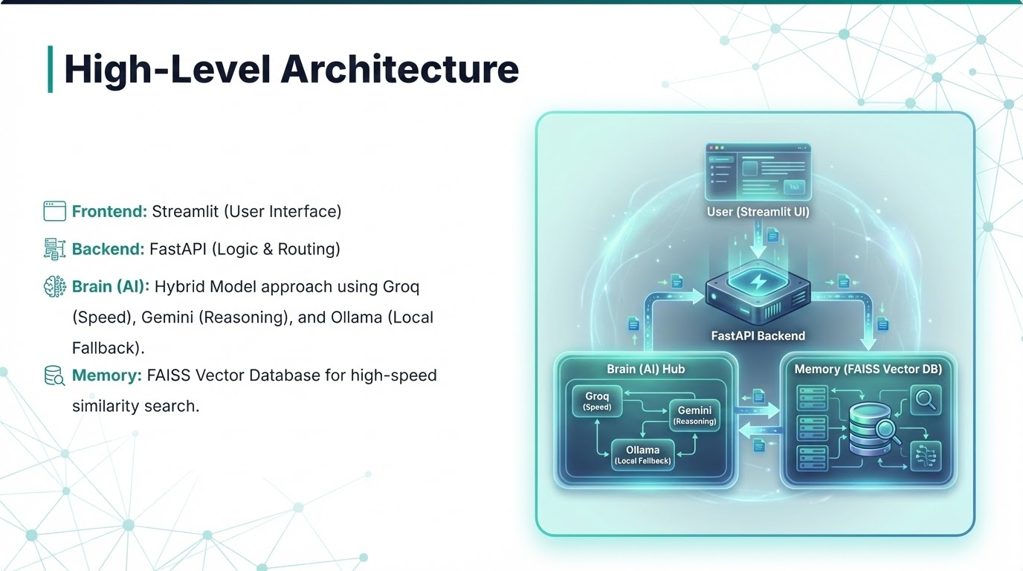

Slide 9
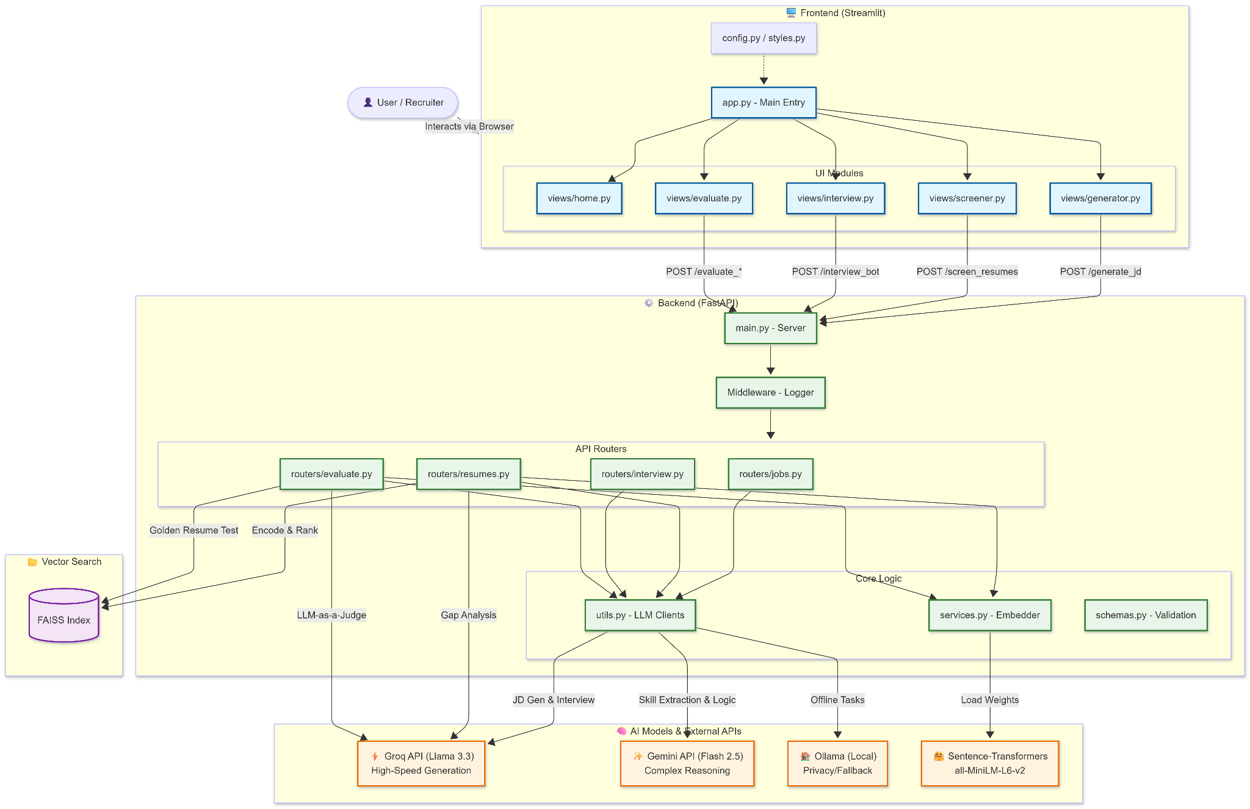

Slide 10


CORE FEATURE
Smart Resume Screening
Traditional keyword matching fails because it misses context. Talentflow AI uses Semantic Search.
Embeddings: Converts Resumes and JDs into vector space using all-MiniLM-L6-v2.
Vector Math: Calculates similarity using Cosine Similarity logic via FAISS.
Result: A ranked list of candidates based on meaning, not just keywords.
"Normalizes vectors first to ensure accurate inner-product scoring."

Slide 11
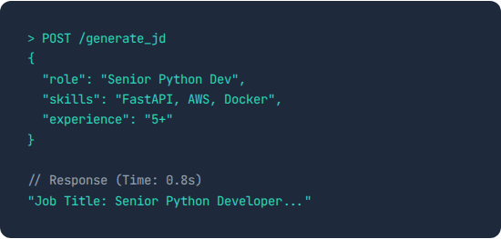
Intelligent JD Generator
Prompt Engineering at Work
Writing a JD from scratch is tedious. We solve this by orchestrating Large Language Models.
Inputs: Role, Years of Experience, Key Skills.
Model: Leveraging Llama-3.3-70b via Groq for ultra-fast generation.
Output: A structured, standardized Job Description ready for posting.

Slide 12

AI Preliminary Interview
Context-Aware Persona
The system adopts the persona of a Technical Recruiter.
Adaptive Logic: If a candidate answers incorrectly, the AI lowers the difficulty. If correct, it probes deeper.
Context Injection: The specific JD text is injected into every prompt to prevent hallucinations.
Safety: "Negative Constraints" prevent the AI from giving away answers.

Slide 13
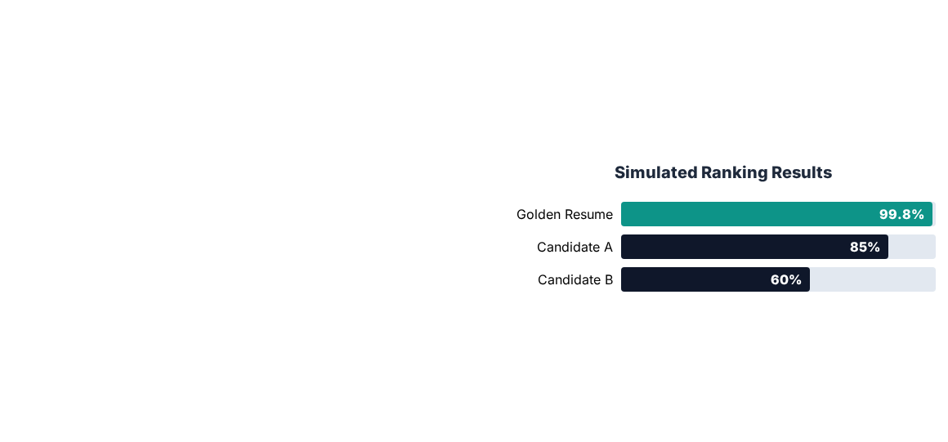
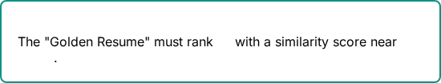
Quality Assurance: The Integrity Check
The "Golden Resume" Test
How do we know the AI isn't hallucinating?
We implemented a diagnostic test where the Job Description text itself is injected into the candidate pool as a resume.
PASS CONDITION:
#1
100%

Slide 14
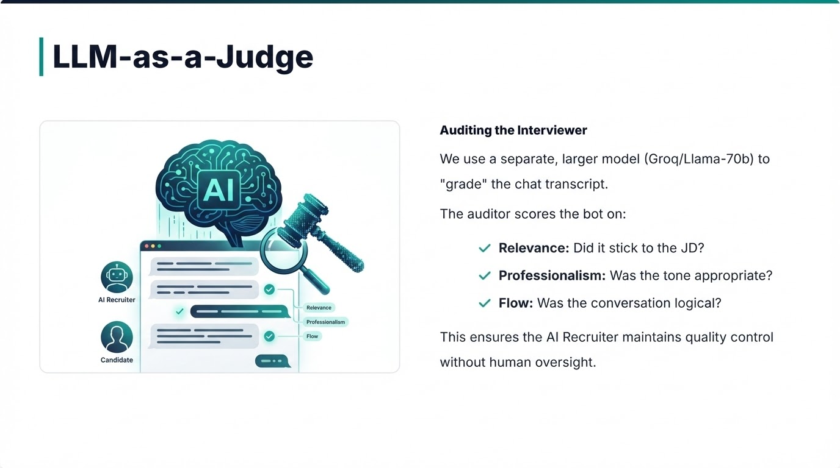

Slide 15



Business Impact
70%
0%
24/7
Reduction in Screening Time
Keyword Bias
Candidate Availability
(Uses semantic meaning, not Ctrl+F)

Slide 16
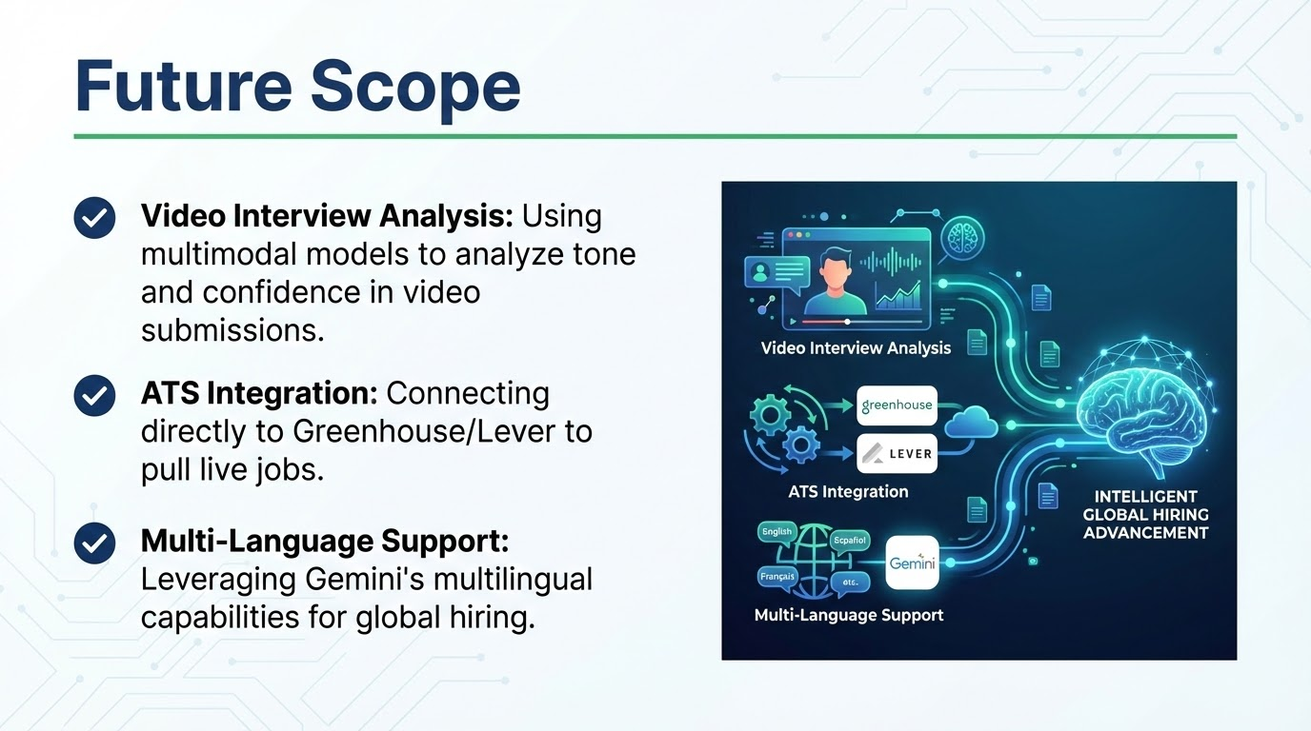

Slide 17
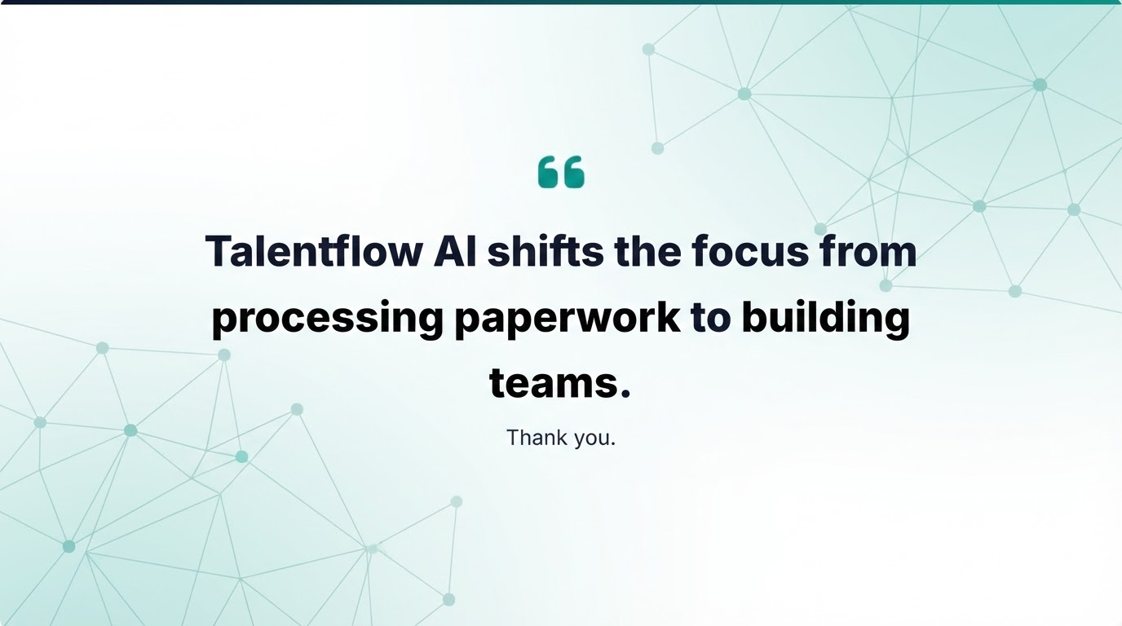

Slide 18
